Slide 1

Stock market Prediction
DSC680 Course Project: Milestone 3 - Project Proposal Vasanthakumar Kalaikkovan

Slide 2
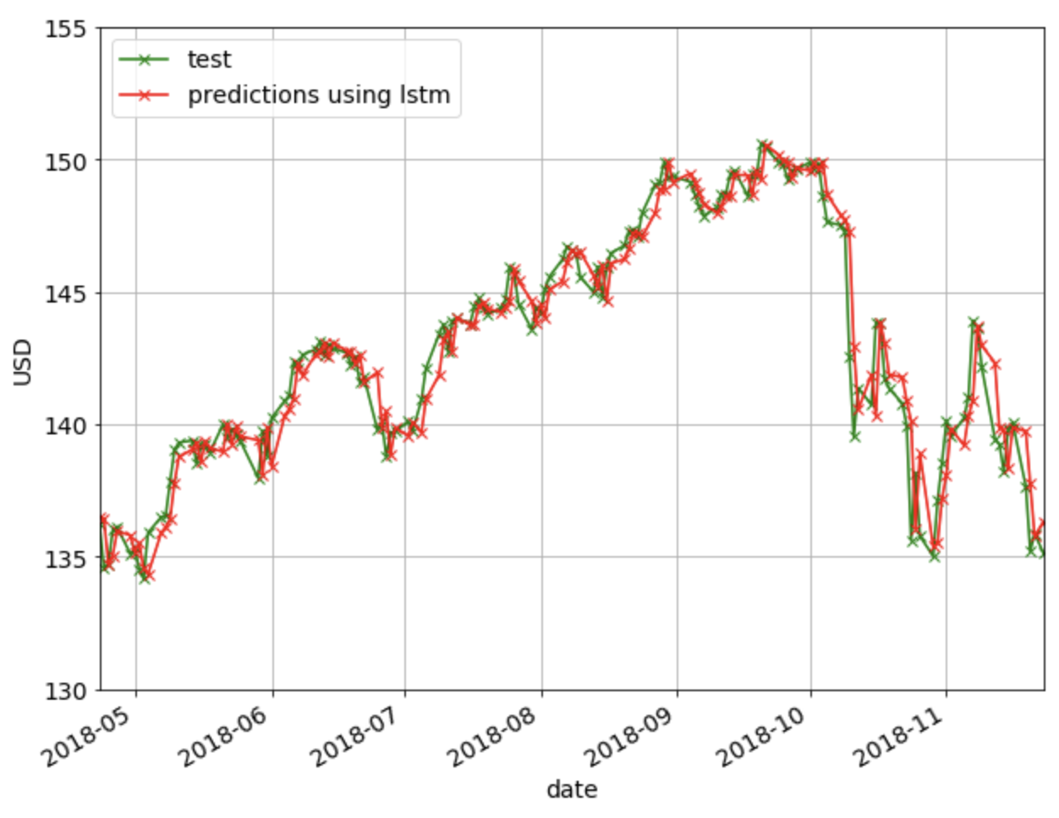
Background of the problem
The challenge of the stock price forecast is the most crucial component for companies and equity traders to predict future revenues.
Stock market prediction is a major challenge owing to non-stationary, blaring, and chaotic data, and thus, the prediction becomes challenging among the investors to invest the money for making profits.
In this research, our objective is to build a state-of-art prediction model for price trend prediction, which focuses on short-term price trend prediction.

Slide 3
Process Overview
Preliminary analysis on data
Data preparation and cleaning
Exploratory Data Analysis
Train and test models
Model evaluation and tuning

Slide 4
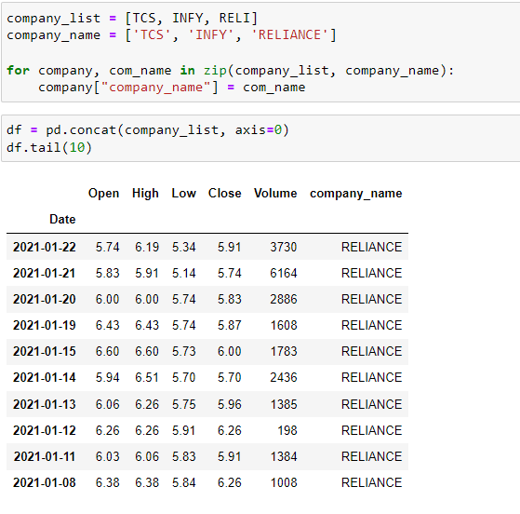
Data Preparation

Slide 5
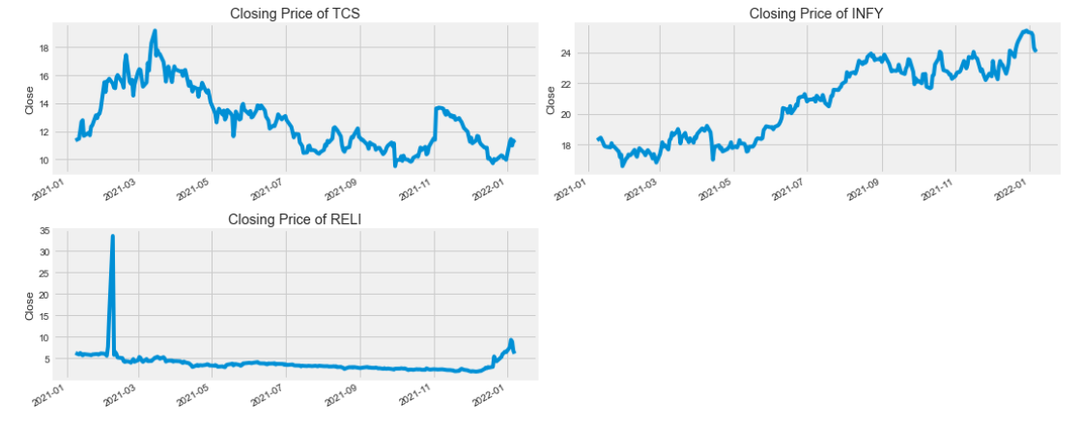
Exploratory Data Analysis (Closing Price of each stocks)

Slide 6
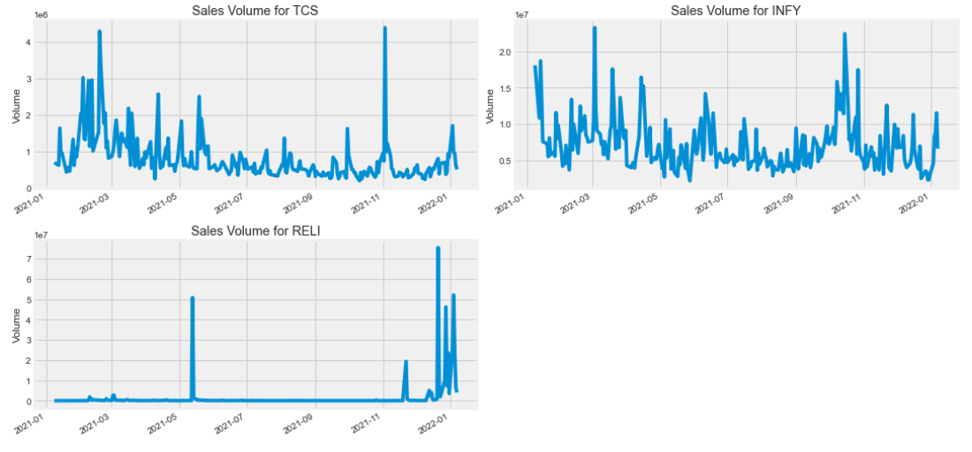
Exploratory Data Analysis (Sale volume of each stocks)

Slide 7
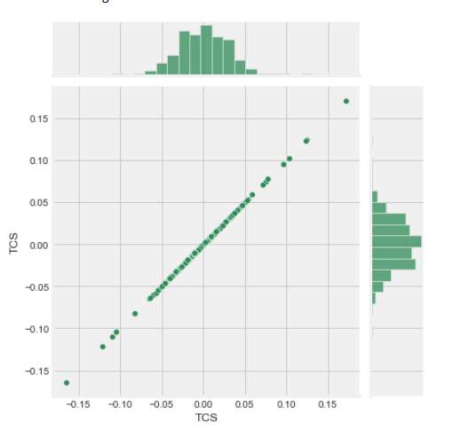
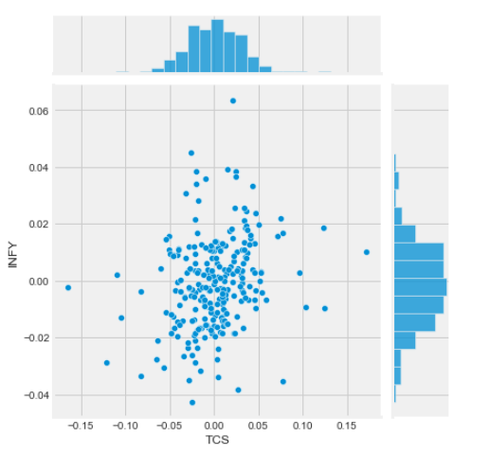
Exploratory Data Analysis (Joint Plot)

Slide 8
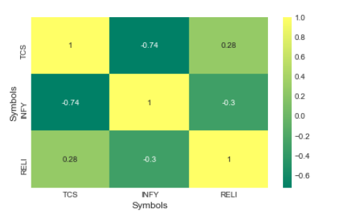
Correlation

Slide 9
LSTM Model
Long Short-Term Memory (LSTM) networks are a type of recurrent neural network capable of learning order dependence in sequence prediction problems.
This is a behavior required in complex problem domains like machine translation, speech recognition, and more.
LSTMs are a complex area of deep learning.
We are using LSTM model to predict the stock price in this project.

Slide 10
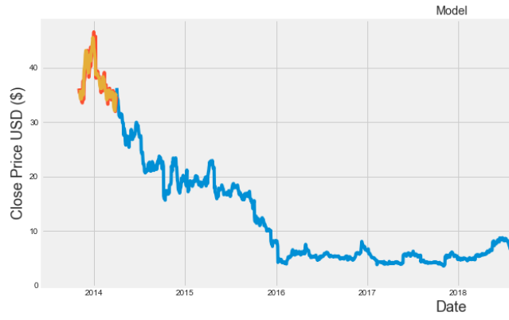
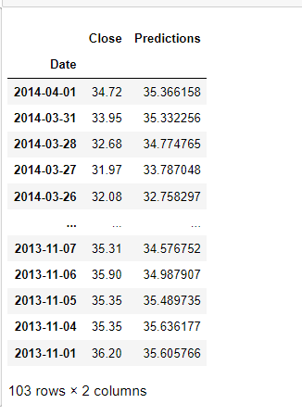
Model Result

Slide 11
Conclusion
After completing the project, we got more than 90% accuracy by using this approach.
We can deploy this project in some server and get the result as API using libraries so that we can deploy this project in any platform to get the result for any stocks listed.

Slide 12
Reference
🤔Stock Market📈 Prediction with Linear Regression | Kaggle
Daily News for Stock Market Prediction | Kaggle
Daily News for Stock Market Prediction | Kaggle

Slide 13
Thankyou

